Slide 1
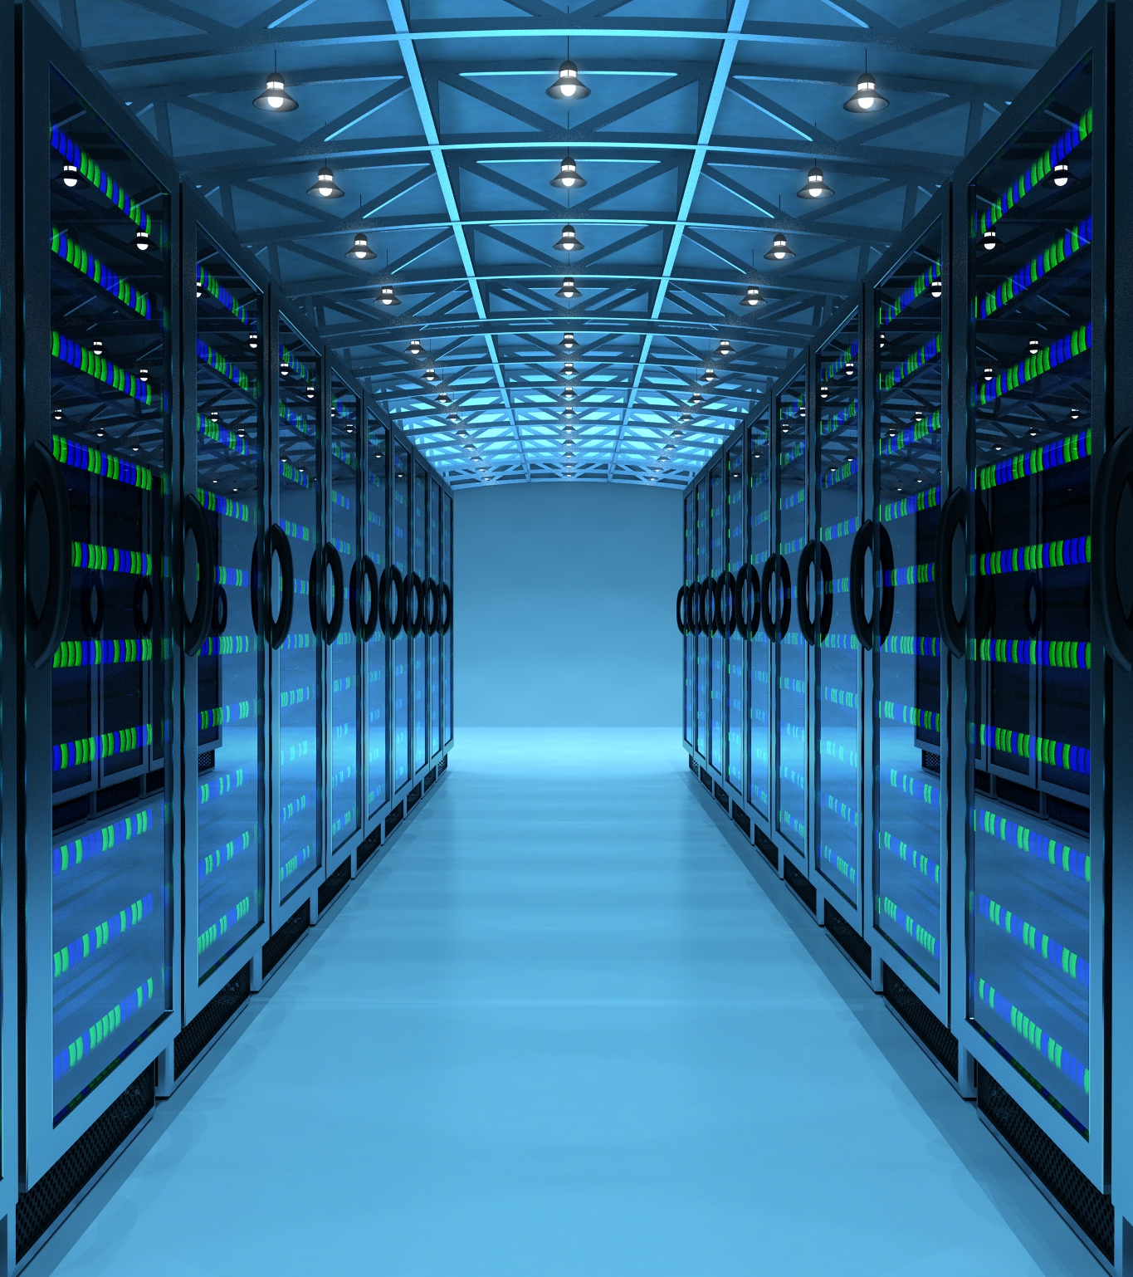
DevOps introduction
Notes:
Timings for 60 minutes of lewcture
Introduction & Context 5 mins
Why DevOps Exists 10 mins
DevOps Principles & Culture 15 mins
Modern DevOps Practices 15 mins
Emerging Trends 10 mins
Wrap-up & Questions 5 mins

Slide 2

Introducing DevOps
By the end of this session, you will be able to:
Explain
why DevOps emerged
Describe
the DevOps lifecycle
Understand
the CALMS framework
Explain
CI/CD and automation
Recognise
DevSecOps and Platform Engineering
Describe
the impact of AI on modern DevOps

Slide 3
From SDLC to DevOps
We have already discussed
Requirements
Design
Development
Testing
Deployment
Maintenance
The Challenge
Traditional SDLC

Slide 4
Modern Development Needs
Faster delivery
Continuous updates
Improved reliability
Rapid feedback
Better security
Key Message
DevOps extends SDLC by making delivery, feedback
and improvement continuous

Slide 5









Software development never ends
Modern lifecycle requires
Plan
Code
Build
Test
Release
Deploy
Operate
Monitor
Discussion
Why is monitoring considered part of development?
Code
Deploy
Plan
Operate
Release
Test
Monitor

Slide 6
The problems DevOps tries to solve
Common Organisational Challenges
Slow releases
Environment inconsistencies
Blame culture
Poor communication
Manual deployments
Security issues discovered too late
Unreliable production environments
Q: Have you experienced any of these?

Slide 7


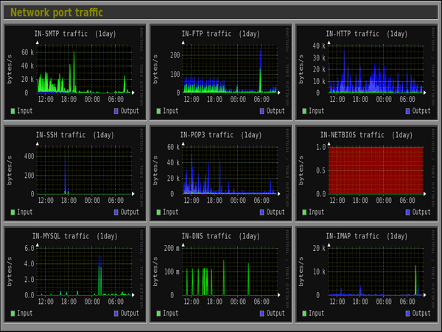
Common Problems DevOps Attempts to Solve
Request for More Server Capacity:
  We need to increase our server capacity to handle the growing demand.
Testing in Production:
  “Wouldn’t it be great if we could test our system directly in the production environment?”
Accountability for Issues:
  An issue has occurred. Who is responsible?
Monitoring System Alerts:
  We get meaningless alerts!

Slide 8
I need more Server capacity
The most common complaint from the business
Ops team are seen as blockers who are not sensitive to the needs of business
Capacity demand often fluctuates without clear reasons
Ops teams manage more than just your app
        🚨 System outages
        🐞 System defects
        🛡️ Incident and Security Management
        💰 Resource and Budget Management
        📈 Monitoring and Improving KPIs
        📜 Compliance
Notes:
I need more server (node) capacity

Slide 9
Another problem
Who caused it this time?
Production
environment
Who should we
take aim at?
Dev Team
Business
Dev Team: Why can’t build software that works?
Ops Team: Why can’t you get the capacity right?
Notes:
Something went wrong, whose fault was it?

Slide 10
Wall of confusion
The wall of confusion
I want change!
I want stability!
Dev
Op
What about Security, Governance,
Risk Management and Compliance?
OPs wants to maintain stability, availability
Dev wants to create change - Conflicting views
Notes:
Emote/RP this out -
DW and ?

Slide 11
Start-ups – Green Fields
Have a great idea
Develop it
Deploy it

Slide 12
Enterprise – Complexity Due to Scale
Have a great idea
Debate it
Get signed off to process
Develop it
Test it
Fix it
Scope out
requirem-ents
Raise required paperwork
Get paperwork signed off
Fix it
Deploy as part of a release
Fix it
Test it as part of the release
Schedule the release

Slide 13
What DevOps
Really Means
DevOps Is Not A Job Title
DevOps is:
A culture
A way of working
A set of practices
A shared responsibility model
Clear goal
Deliver value safely and quickly.

Slide 14

CALMS Framework
C.A.L.M.S
Culture
Automation
Lean
Measurement
Sharing
This framework is still widely used to explain DevOps foundations. Based on the CALMS model already introduced in your original deck.

Slide 15

Culture
High-Performing Teams
Shared ownership
Collaboration
Transparency
Continuous learning
Trust
Blameless retrospectives
Modern Mindset
Fail, learn, improve.

Slide 16
Change of culture
From | To
💻 IT only thinking --------------- 🧱 Teams stuck in silos ------------ 🎯 Control over collaboration ------- 📋 Tasks over outcomes ----------- 👉 Blame instead of learning ------- 🚒 Always firefighting ------------- 🕰️ Comfort in the past ------------ 🛑 Change is resisted ------------- 🔒 Trust is scarce ---------------- 🙈 Mistakes are hidden ------------ 🧊 New ideas do not survive -------- | Customer focus Cross-functional teams Collaborative Outcome-oriented Taking on responsibility Proactive Courageous Flexible High trust Share responsibilities, report failure Novelty is implemented
People don't resist change; they resist being changed. Peter Senge

Slide 17
Develop
Test
Release
Automation
Tools make automation possible
Amazon push code to production
every 11.7 seconds
Notes:
Automate: deployment, infrastructure, builds, deployment, configuration, document management
Benefits: testability, recoverability, consistency, reduction in workload, fewer incidents, greater accuracy
Netflix is well-known DevOps case study. It can deploy code and software updates in minutes across its entire infrastructure.
Deploying too fast is risky and automation needs to take this into account.
Continuous Integration practices allow for continuously releasable software through incremental build and test.
Code in the 'mainline' branch of the version control system is always ready for release, through the use of automated tests that run whenever a developer checks in their code. Many teams use a dedicated CI environment for this purpose
Continuous Integration, by Paul Duvall, with Steve Matyas and Andrew Glover.
http://martinfowler.com/articles/continuousIntegration.html#PracticesOfContinuousIntegration
http://guide.agilealliance.org/guide/ci.html

Slide 18

Automation of Repetitive Activities
Builds
Testing
Deployment
Infrastructure provisioning
Monitoring
Security scanning
Benefits
Consistency
Speed
Reliability
Reduced errors

Slide 19
L – LEAN
🗑️ Eliminate Waste
🛠️ Build Quality In
🧠 Create Knowledge
⏳ Defer Commitment
🚀 Deliver Fast
🤝 Respect People
🌍 Optimise The Whole

Slide 20
Continuous Integration & Continuous Delivery
Continuous Integration (CI)
Developers merge code frequently.
Every change triggers:
Build
Automated testing
Validation
Continuous Delivery (CD)
Software is always ready for release.
Continuous Deployment
Every successful change automatically reaches production.

Slide 21
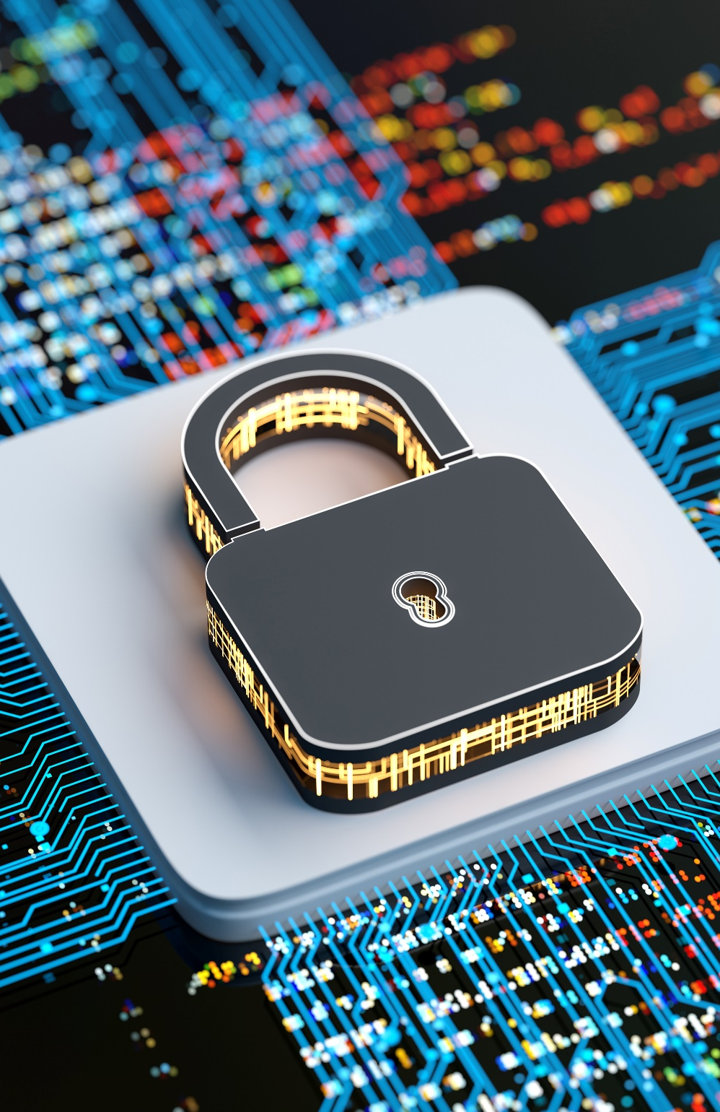
Devsecops
Security Is Everyone's Responsibility
Traditional approach:
Security at the end.
Modern approach:
Security throughout development.
Do:
Automated vulnerability scanning
Dependency checking
Secret scanning
Compliance checks
Shift Left Security
Find issues earlier and cheaper.

Slide 22

Modern Cloud-native DevOps
Instead of:
Physical servers
Manual configuration
We increasingly use:
Containers
Kubernetes
Serverless platforms
Infrastructure as Code
Cloud services
Benefits
Scalability
Reproducibility
Faster deployment

Slide 23
Measuring Success - DORMA Metrics
Metric | Question It Answers
🚀 Deployment Frequency | How often do we release?
⏱️ Lead Time for Changes | How quickly do we deliver?
⚠️ Change Failure Rate | How often do releases fail?
🔧 Mean Time to Recovery (MTTR) | How quickly do we recover?

Slide 24
Platform Engineering
Traditional Model | Platform Engineering
Need a server? Ask Ops | Self-service platform
Need monitoring? Ask Ops | Built into platform
Need security controls? Ask Ops | Built into platform
Need deployment pipelines? Ask Ops | Built into platform
✅ Faster delivery
✅ Consistent standards
✅ Reduced developer friction
✅ Improved security and governance
Results

Slide 25

How AI is changing DevOps
AI coding assistants
Automated test generation
Incident investigation
Log analysis
Security analysis
Predictive monitoring
AI assists engineers. It does not replace engineering judgement.

Slide 26
Summary
DevOps extends traditional SDLC
DevOps is primarily about culture
Automation enables speed and consistency
Security is everyone's responsibility
Cloud, Platform Engineering and AI are shaping modern DevOps
Continuous improvement never stops
Q: If your organisation adopted only one DevOps principle tomorrow, which would have the biggest impact?

